Slide 1
Technical Arts (TA 101AA) Engineering Graphics
Prof. Nachiketa Tiwari
Department of Design

Slide 2
Who is Your Tutor?
NAME | EMAIL | SECTION
PROF. ASHISH DUTTA | adutta@iitk.ac.in | C1
PROF. BISHAKH BHATTACHARYA | bishakh@iitk.ac.in | C2
NEETESH KUMAR (18101267) |  | C3
INDRANEEL SENGUPTA ( 18203262) | neelisg@iitk.ac.in | C4
PROF. K V HARISH | kvharish@iitk.ac.in | C5
MADHAVRAO VITTHAL LONDHE (16205266) | madhavl@iitk.ac.in | C6
MOHD. SUHAIL NAIM ( 18201267) | msnaim@iitk.ac.in | C7
PROF. NALINAKSH S VYAS | vyas@iitk.ac.in | C8
HARISH M. THULASI (17105271) |  | D1
 |  | D2
PRAYAGADHWAJ YADAV | prayagy@iitk.ac.in | D3
RAVI KUMAR (17205266) | ravikm@iitk.ac.in | D4
ROHIT RAJPUT (19103282) | rrajput@iitk.ac.in | D5
SHUBHAM RAJ (18103277) | shubhce@iitk.ac.in | D6
PRASANNABALAJI S. (18101268) |  | D7
TEJAS GUPTA (19103288) | tejasgta@iitk.ac.in | D8

Slide 3
About Lines & Text for Drawings
‘Lines’ represent the shape of an object in the form of either an edge, a surface, or contours of the object
‘Text’ is used to describe the size and other necessary information
Lines & text along with certain symbols, abbreviations, and standard practices collectively make the complete description of an object on an engineering drawing

Slide 4
Types of Lines
Object- Continuous thick
Dimension-Arrowed line
Construction-Continuous thin
Hidden-Dashed line
Center line-Chain thin
Hinge line-Chain thick

Slide 5
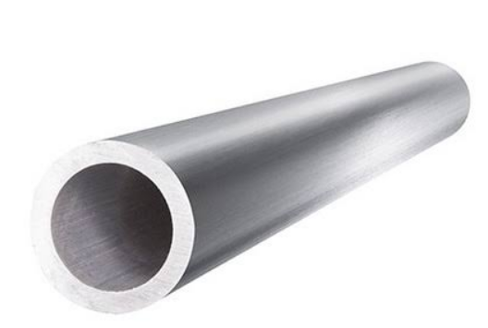
Types of Lines
Center Line
Object Line
Viewing from top
100
Top View
Construction Line
Hidden Line
Viewing from front
Front View
NOTE
Object lines and construction lines should always be distinguishable.
Use H for object lines and 2H for construction lines
Do NOT erase the construction lines after drawing during this course.

Slide 6
About Letters and Text
•Guidelines for text.
• Light pencil lines –
use 2H/H pencil.
•For capital letters,
draw only cap line
and base line.
•Waist line and drop
line required for
lowercase letters.
Atg
Cap Line
Waist Line
Base Line
Drop Line
Lower case letters = 2/3 of upper case letter
Cap line and drop line are 1/3 each from waist and base lines
e.g. Upper case letter = 9 mm
Lower case letter = 6 mm
Cap and drop lines = 3 mm

Slide 7
Principles of lettering
Text on engineering drawing is usually in UPPERCASE.
Title block: 8/6 mm, Dimensions : 6 mm
Each letter is made up of a series of single strokes.
Spacing between letters should be uniform.
Letters and Number using H Pencil
Use only UPPER CASE letters and numbers.

Slide 8
Principles of lettering
Legibility: Each letter must be distinct.
Stability: The bottom of letters such as B are larger than the top.
Composition: Each portion of each letter is formed to a standard.
Uniformity: All “A’s” are alike, all “B’s are alike, etc.
Alignment: All letters should be vertical. No slant!

Slide 9

Lettering : Acute Angle Stroke
ü
û
Stroke the pencil in the acute angle direction. This will save the paper from tearing

Slide 10
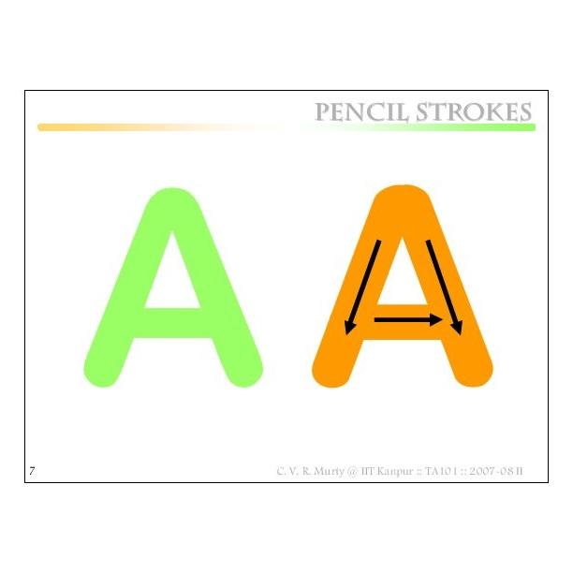

Slide 11
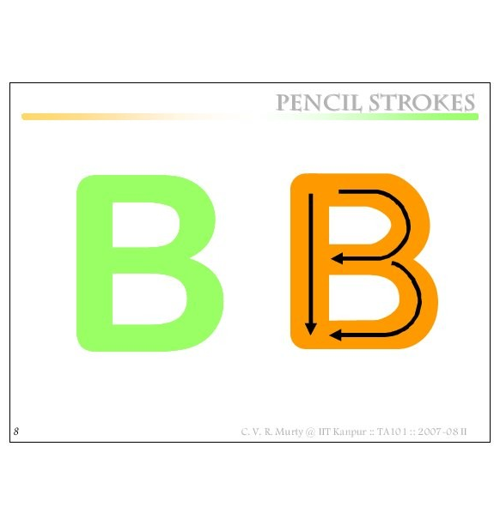

Slide 12
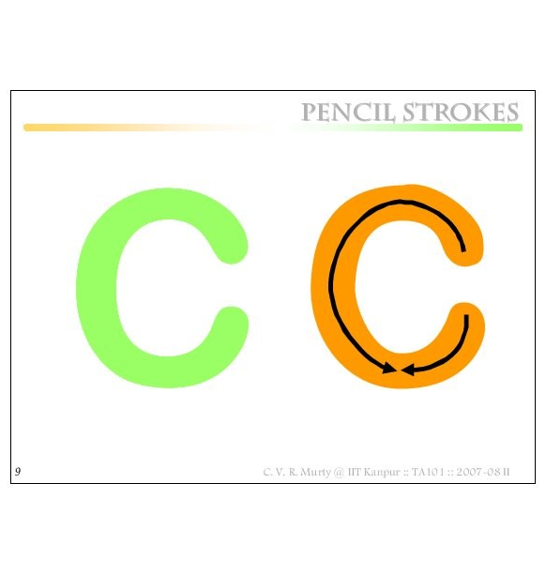

Slide 13
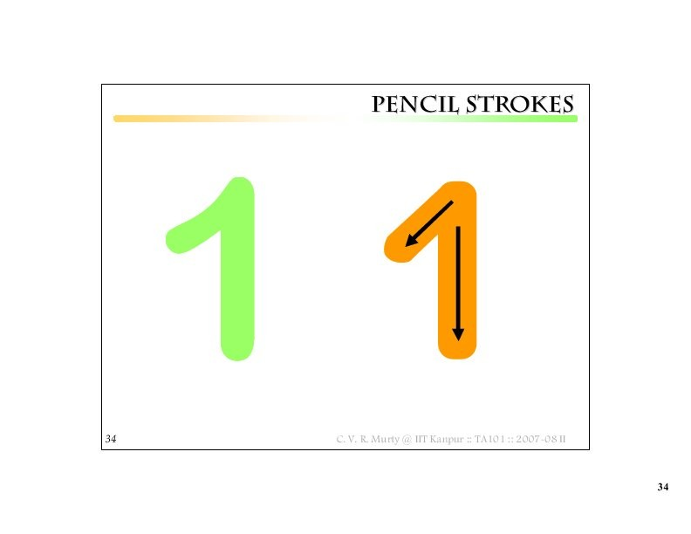

Slide 14
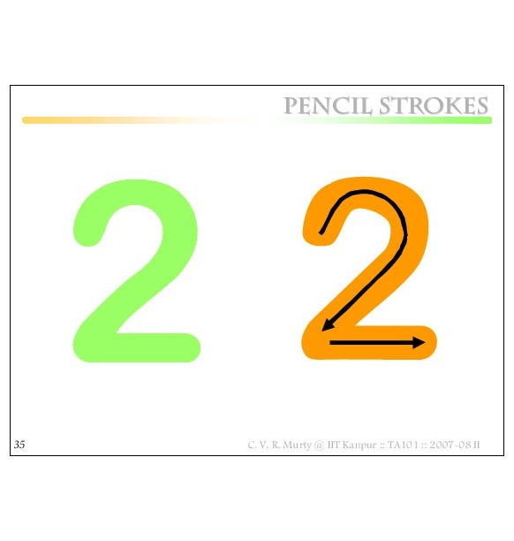

Slide 15
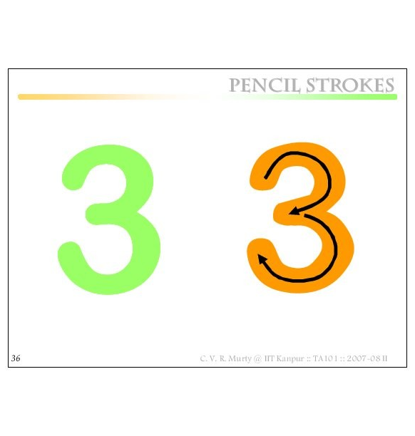

Slide 16
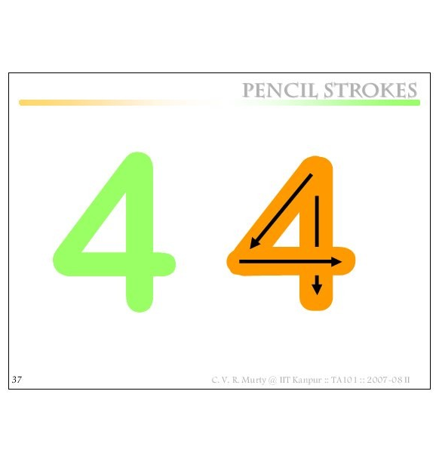
USE THIS IN ALL DRAWINGS

Slide 17
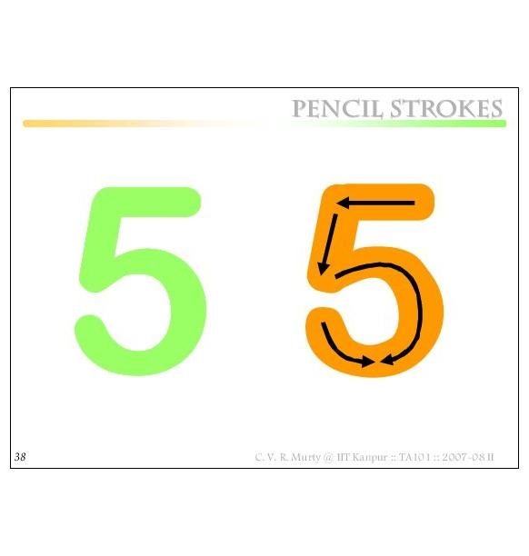

Slide 18
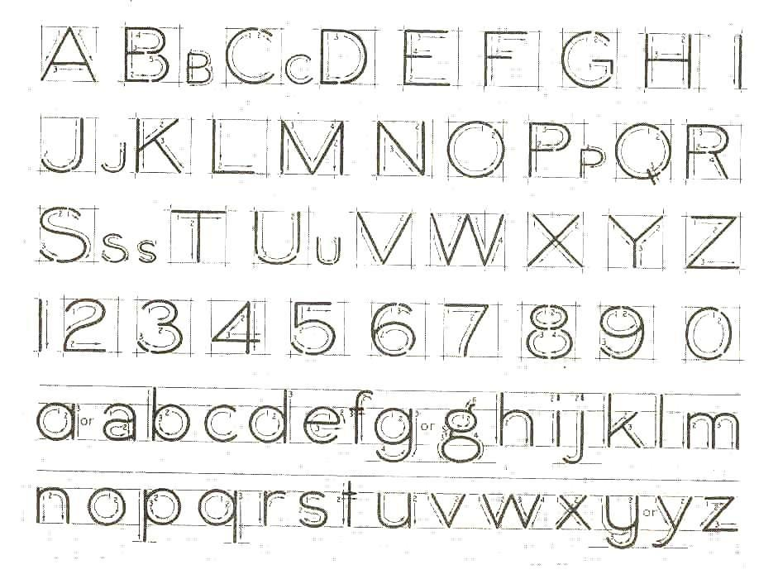
Lettering practice ! (Lab & Home)

Slide 19
Why take so much trouble?
Drawings made in one country may be used for manufacturing parts or assembly in another country !
Need for STANDARDS !
(BIS, DIN, JIS, ASTM …)

Slide 20
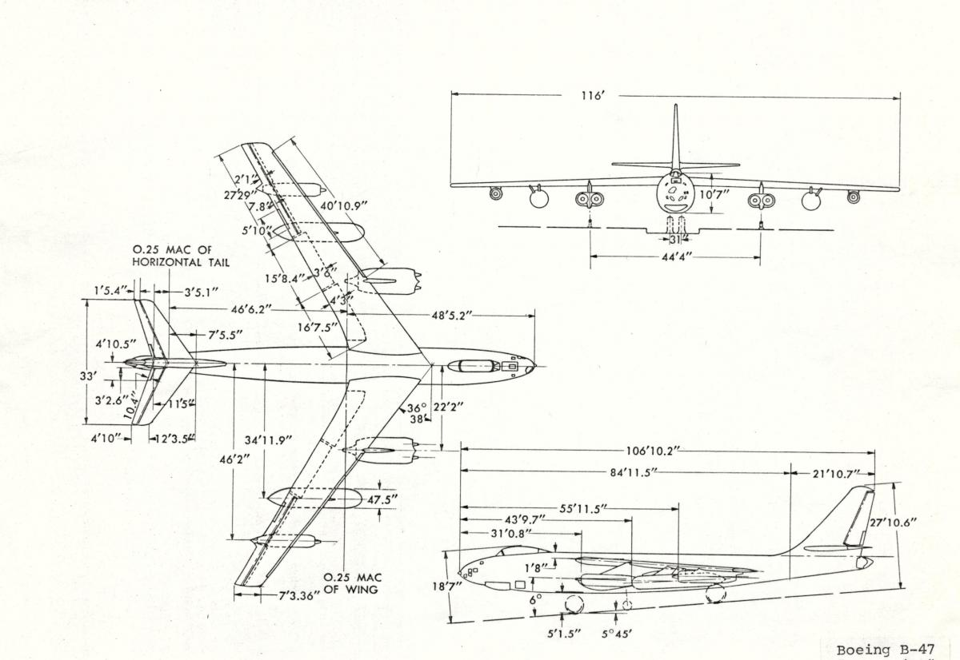
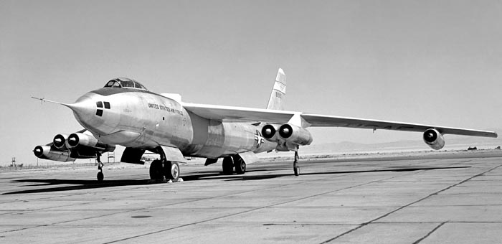
Scales
Some scales.
1:2, 1:5,1:10, etc.
Note: Drawings specify the actual dimension. Always!
Note: A drawing should always mention the scale.

Slide 21
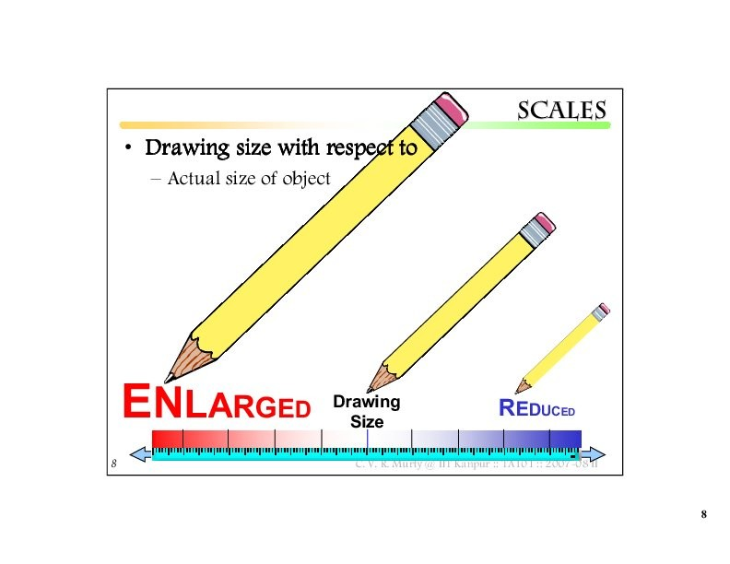
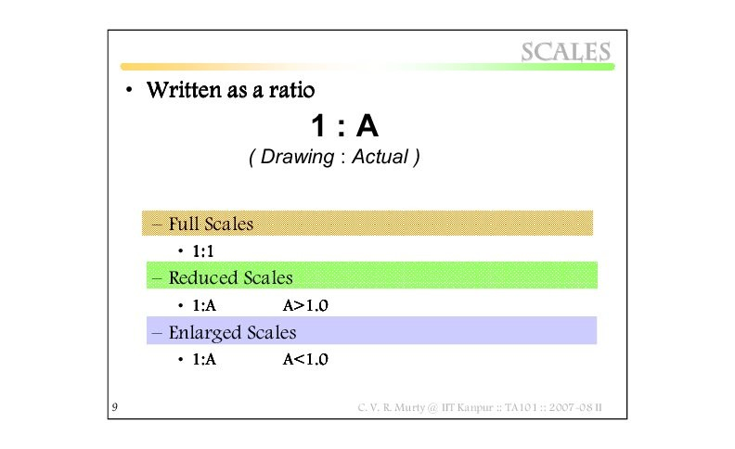
SCALES

Slide 22
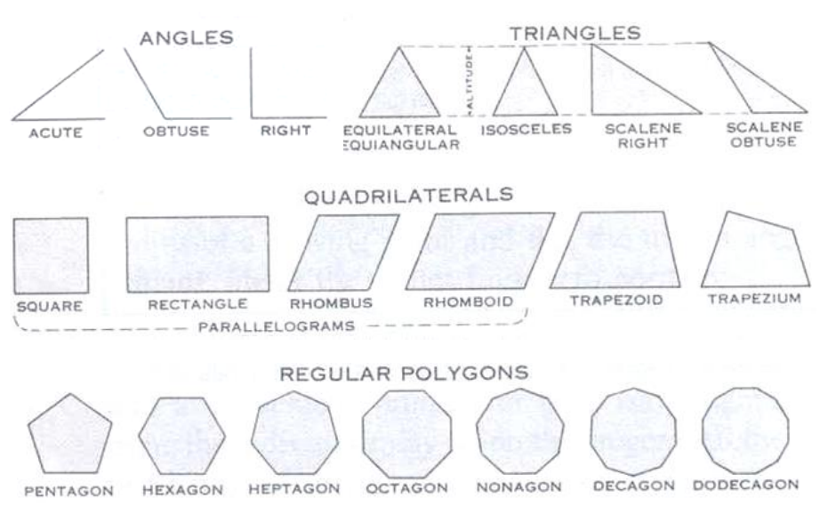
Some Basic Geometric Shapes
5 6 7 8 9 10 12

Slide 23
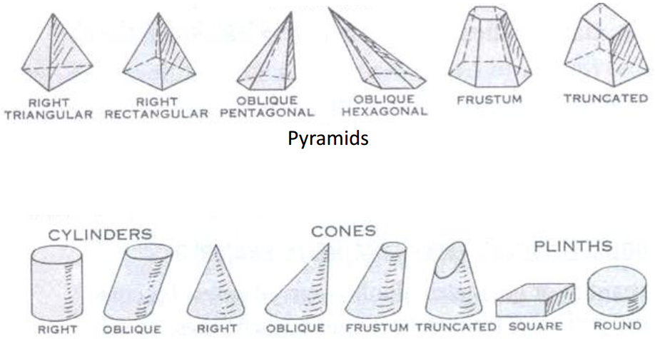
Some Basic Geometric Shapes
Cylinders and Cones

Slide 24
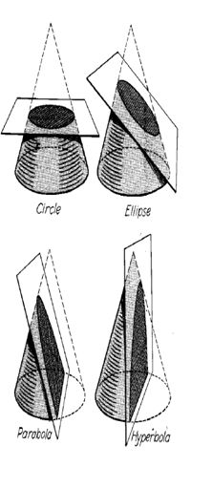
Conic Sections
Circle: Cutting plane perpendicular to conic axis.
Ellipse: Angle between cutting plane and
axis exceeds than conic half-angle.
Parabola: Angle between the cutting plane and axis is equal to conic half-angle.
Hyperbola: Angle between the cutting plane and axis is less than conic half-angle.

Slide 25
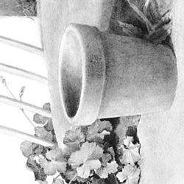
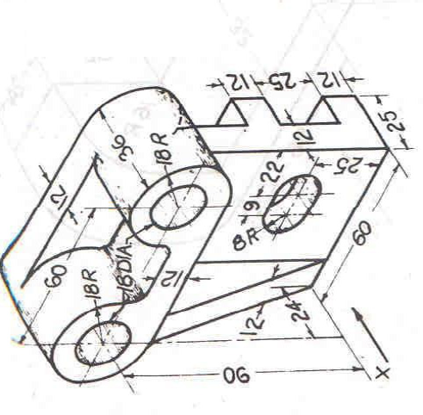
Importance of Drawing Ellipse
A circle appears to be an ellipse when viewed at an angle.
Sharp edges: Not preferred, usually replaced by fillets with circular/elliptic arcs

Slide 26
Ellipse: Terminology
D
Ellipse: is a curve generated by a point moving such that the sum of its distances from the foci equals the major diameter.
Minor Dia.
Radius=1/2(Major Dia.)
F1
Major Dia.
F2
A
B
P
E
AB : Major diameter.
DE : Minor diameter.
F1 , F 2: Focii

Slide 27
Ellipse: Construction Using Strings
https://youtu.be/TEOH982-2Is

Slide 28
Concentric Circle Method:
When Diameters are Known
• Draw concentric circles with AB and DE as diameters.
• Draw a bunch of radial lines.
• From P, Q, etc. draw
lines parallel to OD and from P', Q', etc. draw lines parallel to OB.
Q
• The intersections of lines
through P and P‘,Q and Q', etc.
give points on the ellipse.
D
P
Q’
P’
A
B
O
• Have closely
paced points near
the major diameter.
E
2b
An exact method
2a

Slide 29
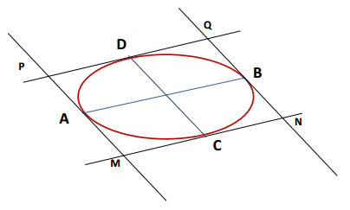
Conjugate Diameters of an Ellipse
• An ellipse has infinite number of pairs of conjugate diameters.
• Two dias form a conjugate pair when each diameter is parallel to the tangents at the ends of the other diameter.
The angle between conjugate diameters is 90° when we have major and minor dia.
• AB and CD form a conjugate pair. Thus:
AB // MN, & PQ AND CD //MP & NQ.

Slide 30
Parallelogram Method
• Divide AG as well as AO into X number of equal parts, and number the division marks.
• Can be used when any pair of conjugate diameters are known.
G
D
3
2
1
A
O
B
1
2
3
E
• Using given diameters AB and DE construct a parallelogram.
• Through these points draw lines from D and E as shown.
• Their intersections will be points on the ellipse.
An exact method

Slide 31
Identifying Major/Minor Dia when Other Conjugate Dia are Used
• Their intersections will be points on the ellipse.
• On the given diameters AB and DE construct a parallelogram.
G
J
D
• With O as centre, OD as
radius draw a arc cutting
the ellipse at H
3
2
• Divide AG into any number of equal parts and AO into the same number of equal parts, numbering
points from A.
Conjugate
diameters
1
N
A
O
B
1
2
3
• Join the line DH
and draw parallel line
to DH cutting the
ellipse at J and K to
get minor axis
major axis
M
minor axis
H
K
E
• Through these points draw lines from D and E as shown.
• Through O draw a perpendicular and cutting the ellipse at point M and N to get the major axis

Slide 32

Conjugate Diameter Ellipse – Circle method
• From S, P, etc. draw lines parallel to QD and RE from S', P', etc. draw lines parallel to OD.
• Conjugate diameters AB and DE given.
S
Q
P
• Draw a circle with AB as diameter.
D
• Draw OQ and OR perpendicular
to AB.
A
O
B
• Join QD and
RE
• Intersection of lines through P & P', S & S', etc. give points on the ellipse.
• From a number of points on either side
of Q, such as P and S, draw perpendiculars PP', SS', etc. to AB.
E
S’
R
P’
Approximate method

Slide 33

Four-Center Method
• Bisect AF by a perpendicular which crosses AO at G, and DE at H.
• Join A and D.
A’
H’
D
• With O as centre and OA as radius, mark A'.
F
• Mark OG = OG’
and OH = OH’
A
O
B
G
G’
• With D as centre and DA' as radius, located point F
E
• G, G', H and H' become CENTERS for four tangent circle arcs forming a curve approximating the shape of an ellipse.
H
Approximate method

Slide 34
Perpendicular from a point to a given line:
Perpendicular from a point on a given line:
• Point P as centre; any convenient radius R1; draw an arc intersecting given line at A and B.
• Any convenient centre C and radius CP.
• Draw an arc slightly larger than a
semicircle from the intersection of
the arc with the given line at A.
• Any convenient radius R2; centres at A and B; draw intersecting arcs locating Q.
• Extend AC to meet the circle arc at Q.
• PQ required perpendicular.
• PQ required perpendicular.
P
Q
Q
R1
C
S
R2
x
A
R2
B
A
A
B
P
R2
R2
P
R1
R1
Q

Slide 35
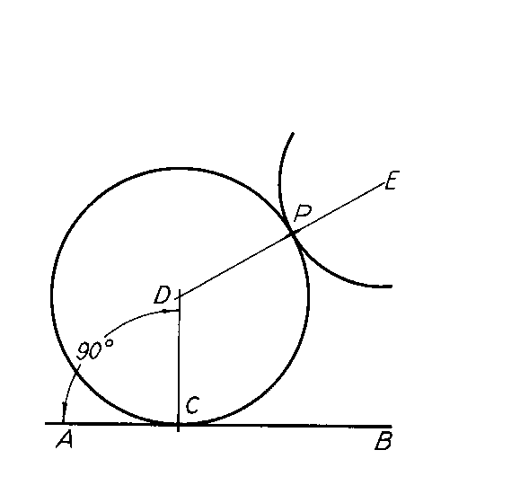
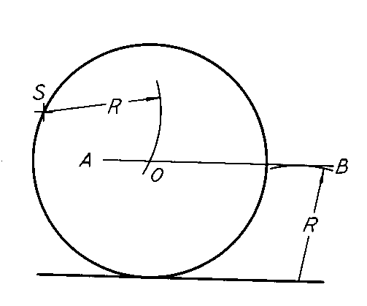
Drawing Tangents
• Drawing tangent for a circle at point C.
Draw radius DC.
Draw line AB, which is perpendicular
to DC.
C will be the tangent point.
• Circle of radius R passing through point S
and tangent to a given line.
- Draw line AB parallel to given line
at distance R. This gives you R.
- Given point S as center, cut line
AB at O with an arc of the given
radius R.
- Now O is the center of the circle.

Slide 36
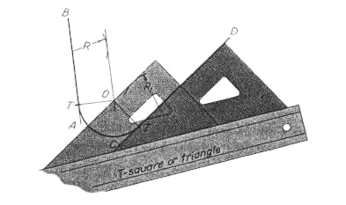
Tangent Arc: Engineering Requirement?
Required: You have two lines, AB, and CD. You want to connect them tangentially through an arc of radius R.
• At any convenient point on the given lines draw arcs R and Rl.
• Draw parallels to the given lines through the limits of the arcs.
• Their intersection at point O is the center of the required arc.

Slide 37
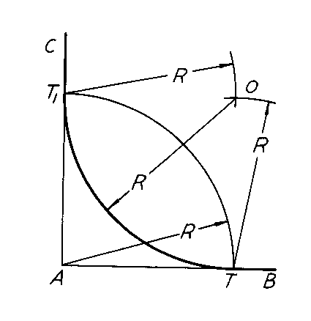
Tangent Arc: Engineering Requirement?
Required: An arc of radius R which is tangential to two perpendicular lines.
• Draw an arc of radius R with center at corner A.
• With T and Tl as centers and with the same radius R draw arcs intersecting at O.
• O is the center of the required arc.

Slide 38
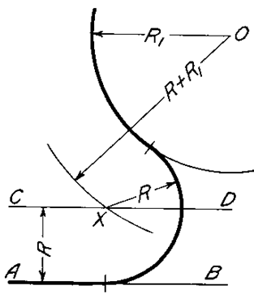
Tangent Arc: Engineering Requirement?
An arc of given radius R tangent to a given circle and line AB.
• AB is the given line and R1 is the radius of the given circle centered at 0.
• Draw a line CD parallel to AB at a distance R from it.
• With O as center and radius R + R1, swing an arc intersecting CD at X.
• X is the center of the desired arc.
• The tangent point for AB will be on
a perpendicular to AB from X.
• The tangent point for the two
circles will be on a line joining their
centers X and 0.

Slide 39
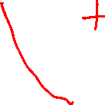
Tangent Arc: Engineering Requirement?
CASE I: Centres of given arcs inside required arc.
• R1 and R2 are the radii of the given circles with O and P as their centres.
O
R1
R+R1
• With O as centre & radius R - R1, draw an arc.
• P as centre & radius R - R2, draw another arc.
• Intersection point Q is the centre of the required arc. Tangent points on lines joining centres: OQ, PQ.
R
Q
R2
R (Radius of the arc)
R+R2
P
CASE II: Centres of given arcs outside required arc.
R1
R2
O
R
P
• O and P as centres. With radii R+R1 and R+R2, draw arcs intersecting at Q.
R-R1
R-R2
• Q is the centre of the required arc.
• Tangent points on lines joining centres: OQ, PQ.
Q

Slide 40
Line and angle bisectors
L

Slide 41
Polygon: Hexagon
Circumscribing circle
Inscribing circle
d
d
60
Vertex-to-vertex distance
Distance between flats

Slide 42
Septagon or any regular polygon
Given a side
A
B

Slide 43
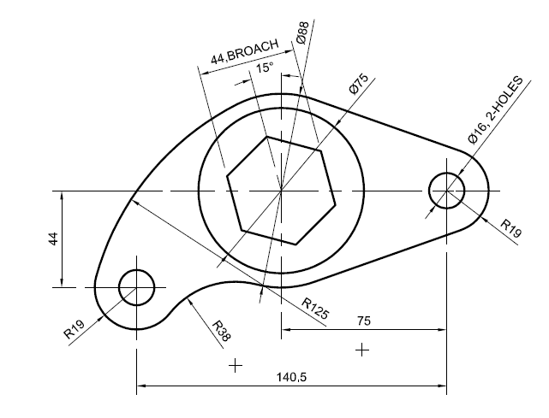
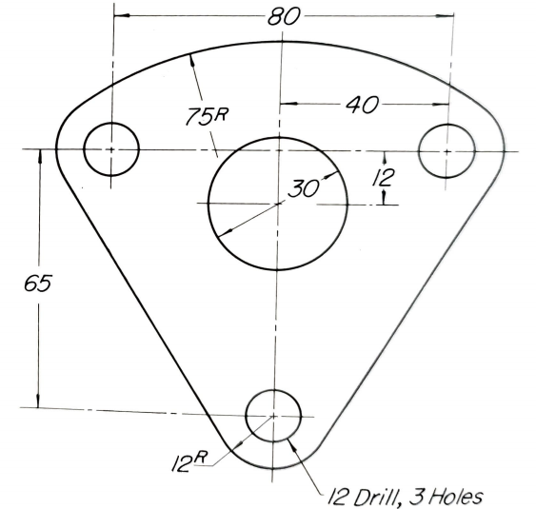
Examples involving concepts learned so far

Slide 44
END

